Slide 1

Free Healthcare and Education for All: Reality or a Left-Wing Utopia?
Notes:
*Add one slide which gives Idea of what I’m going to discuss today
*Emphasize One Big Point

Slide 2
How U.S. Manages Its Economy
Modern Monetary Theory
The Other Side
Who Wants The Free Stuff?
Notes:
Today we are going to talk about:
How federal government does economics
New school of thought about how government should do economy
Criticism of this new school of thought
My research regarding above mentioned topic

Slide 3
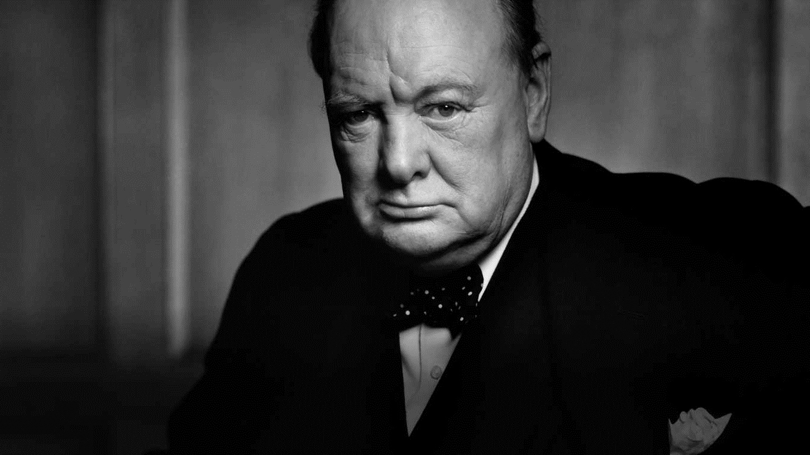
“The best argument against democracy is a five-minute conversation with the average voter.”
- Winston Churchill
Notes:
Year after year we have seen politicians taking advantage of ill-informed voters giving these bizarre promises

Slide 4

20
20
Notes:
Some prominent candidates are campaigning on free healthcare free education promises and it’s crucial to understand how they plan to execute their proposals how they plan to finance those promises. So it’s our duty to be well prepared for this election. Here is where MMT comes in play

Slide 5
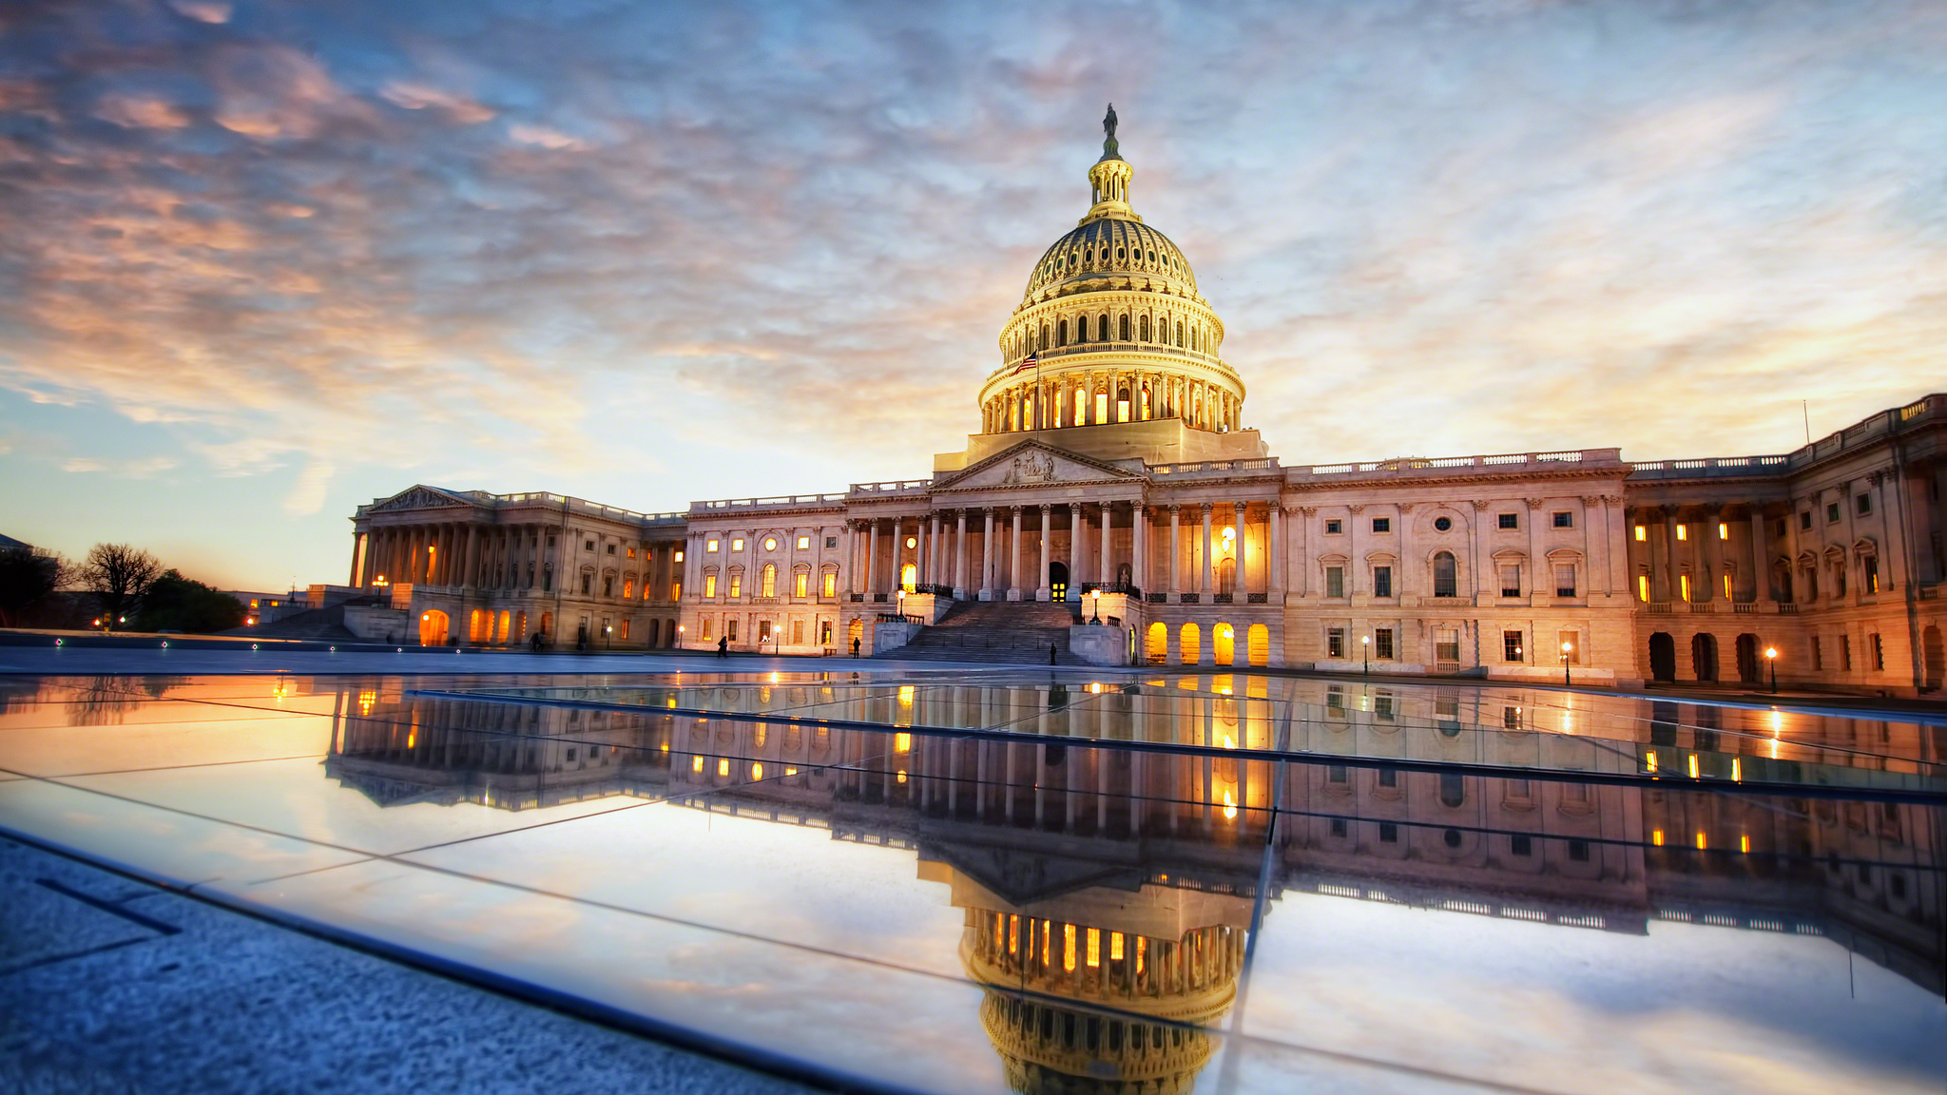
Notes:
Before jumping into the MMT first we need to take a look how US gov operates now. Fiscal policy and Gov budget is managed by congress

Slide 6
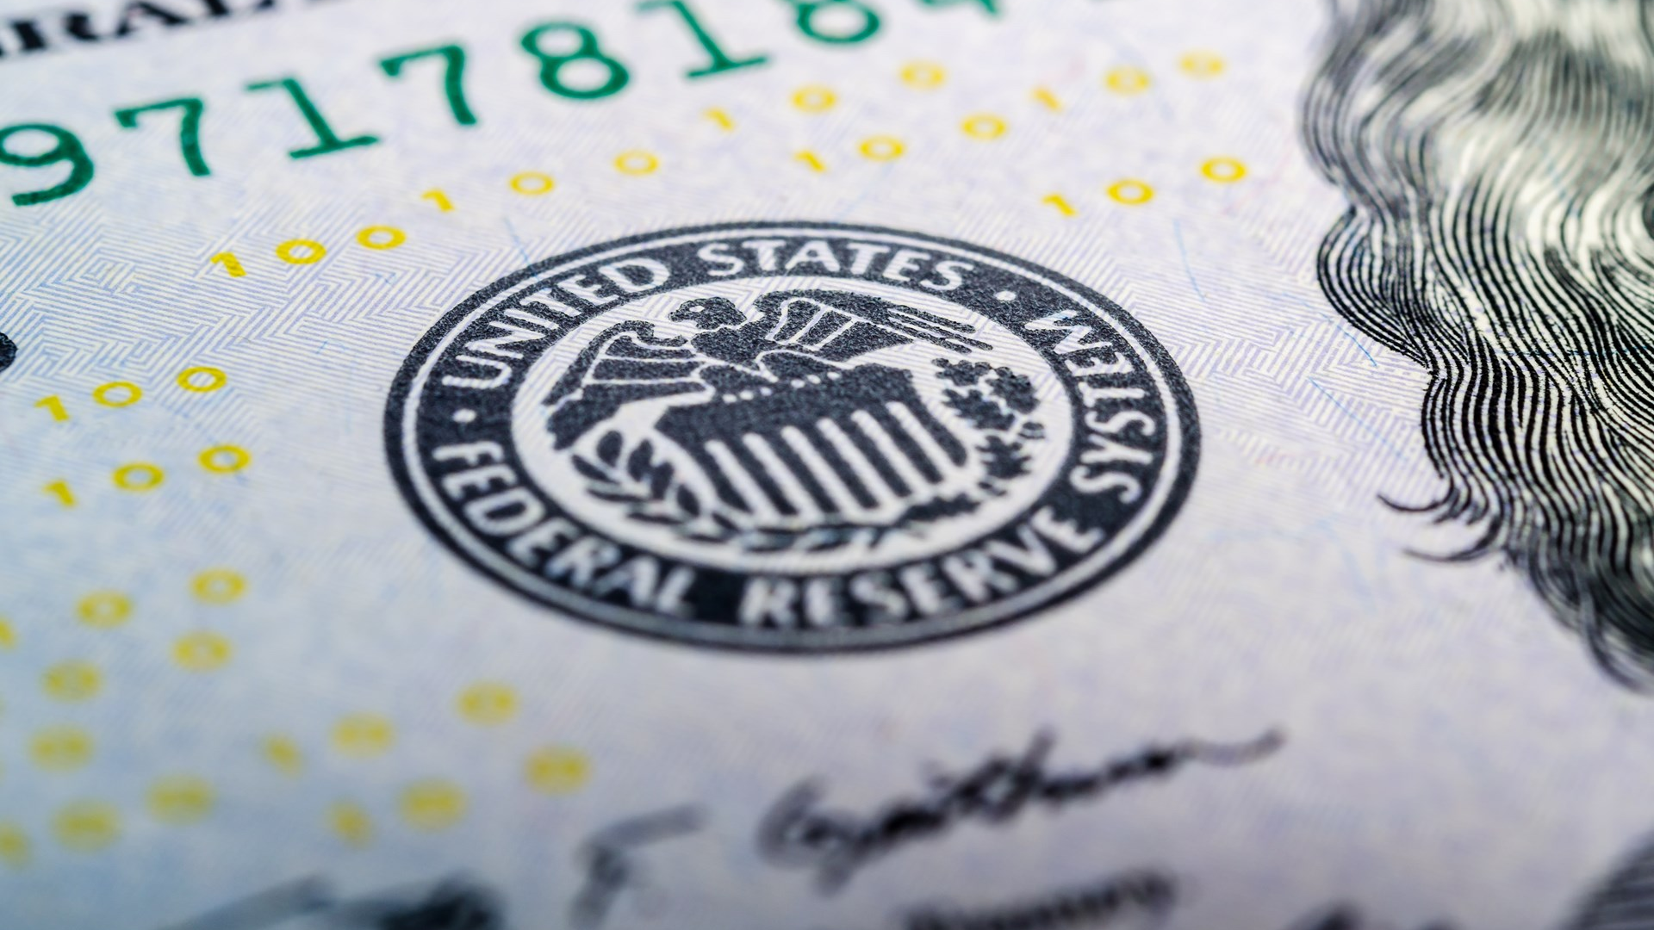
Federal Open Market Committee
Notes:
and monetary policy through FOMC, who is responsible for financial stability and maximum employment.

Slide 7


Notes:
2007 recession when Fed’s injected money banks were skeptical that borrowers were able to pay back so kept excess money in reserves instead of lending them out.

Slide 8
Modern Monetary Theory
MMT
Notes:
And here is where MMT comes in and they say that “you guys are doing it wrong” “you guys are wasting a lot of potential”

Slide 9
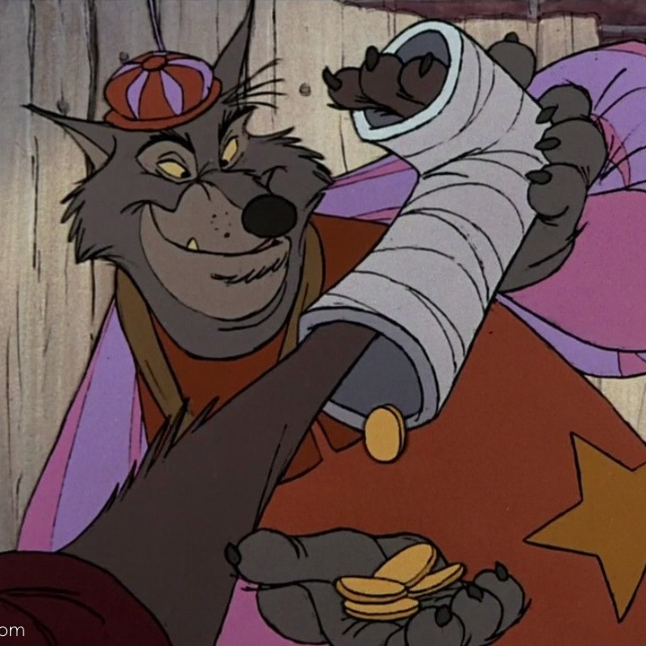

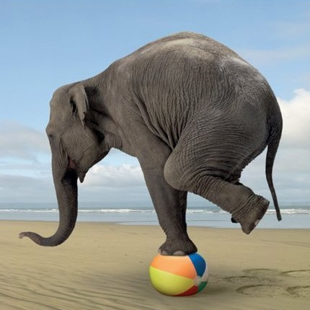
Notes:
1.Government is cyclical and Dems have to increase taxes
2.Gov is not business they can print money they don’t need to earn in order to spend and they also retain the profits
3.Instead of balancing budget concentrate on inflation to guarantee stability. And if Gov spends on tech and education and infrastructure it will have later payoff with increased output which will pay for the increased spending
*Stephanie Kelton economists who talks about it now

Slide 10

Notes:
Government should always run budget deficit because if they run surplus that means they are holding public’s money idle and economy is losing potential output

Slide 11
The Other Side
Criticism

Slide 12

Hyperinflation
Notes:
They say if government has the unlimited power of printing dollars there is not way they can maintain inflation within the constrains. Prices will start growing rapidly,

Slide 13
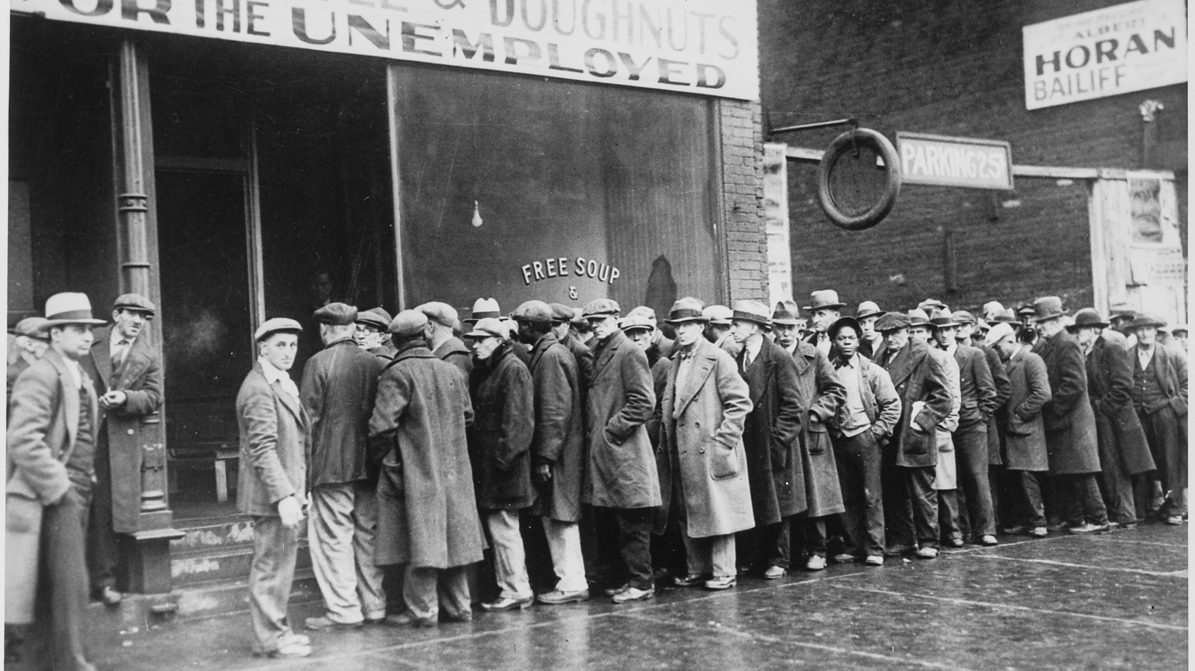
Notes:
and if gov tries to slow it down with taking money out of economy and increase interest rates this will surge unemployment and create depression and economy can even collapse;

Slide 14
Who Wants the Free Stuff?
Original Research
Notes:
Time will not allow me to jump into the math behind MMT but you need to be well prepared before making important decision. So Google it, search on YouTube, educate yourselves!

Slide 15


36.7%
36.7%

Slide 16
84%
Support free healthcare, education, or both!

Slide 17
1/10
Who affiliated as a Democrat knew about MMT

Slide 18

Notes:
Chicago Bears have a higher chance of winning the supper bowl next year than a democrat who wants free stuff to know how it’s possible

Slide 19

Rethink
Notes:
I’m not saying MMT is good, I’m not saying MMT is bad, MMT allows us to start the discourse about the better future, and without discourse there is no better future. So let’s rethink the economics together!

